Slide 1

Bulk RNA-Seq Data Standards and Processing Pipeline
Antonia Chroni, PhD
Senior Bioinformatics Research Scientist
DNB Bioinformatics Core
September 19, 2024
Notes:
This training is part of the training series organized by the Bioinformatics core at DNB.
We will discuss applications and key steps for RNA-sequencing, QC pre-processing and data analysis.

Slide 2





Bioinformatics core, Department of Developmental Neurobiology
Providing advanced bioinformatic services for investigators to leverage omics data
Training
Innovation
Project analysis
Benchmarking
CAB liaison
Consultation
Notes:
At the Bioinformatics core at DNB, we support project analysis. We benchmark methods and tools to find the best one depending on the project and data analysis in need. We generate automated pipelines that can allow for reproducibility and can be available upon request for code review process during the paper submission.
We are here to help you decide on what method and tool and data analysis strategy make the most sense for your research questions and to facilitate discussion with the Center for Applied Bioinformatics (CAB) St. Jude Research.
We have more trainings coming up, so stay tuned, and we are happy to provide trainings on specific sequencing technology or steps of it that is useful to you and your Lab’s needs.
We encourage you to reach out and ask us questions as this also helps us to think outside of the box, innovate and create tools and modules of analysis that will help us altogether to understand omics data and find cures for these pediatric catastrophic diseases.

Slide 3
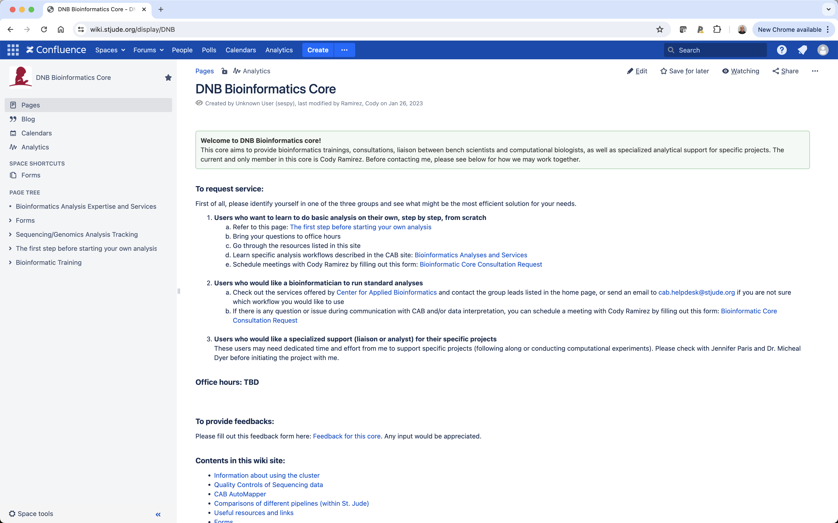
Let us help you! – https://wiki.stjude.org/display/DNB

Slide 4
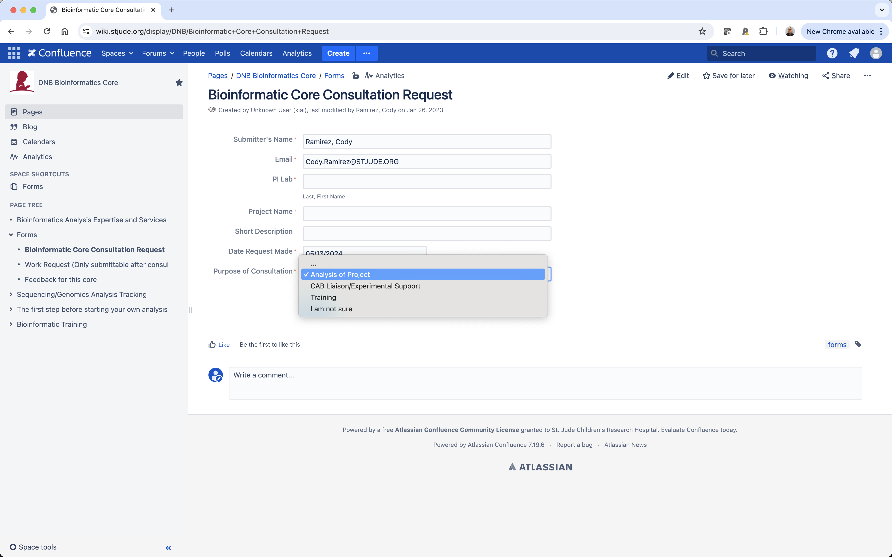
Talk with us! – Consultation Request

Slide 5
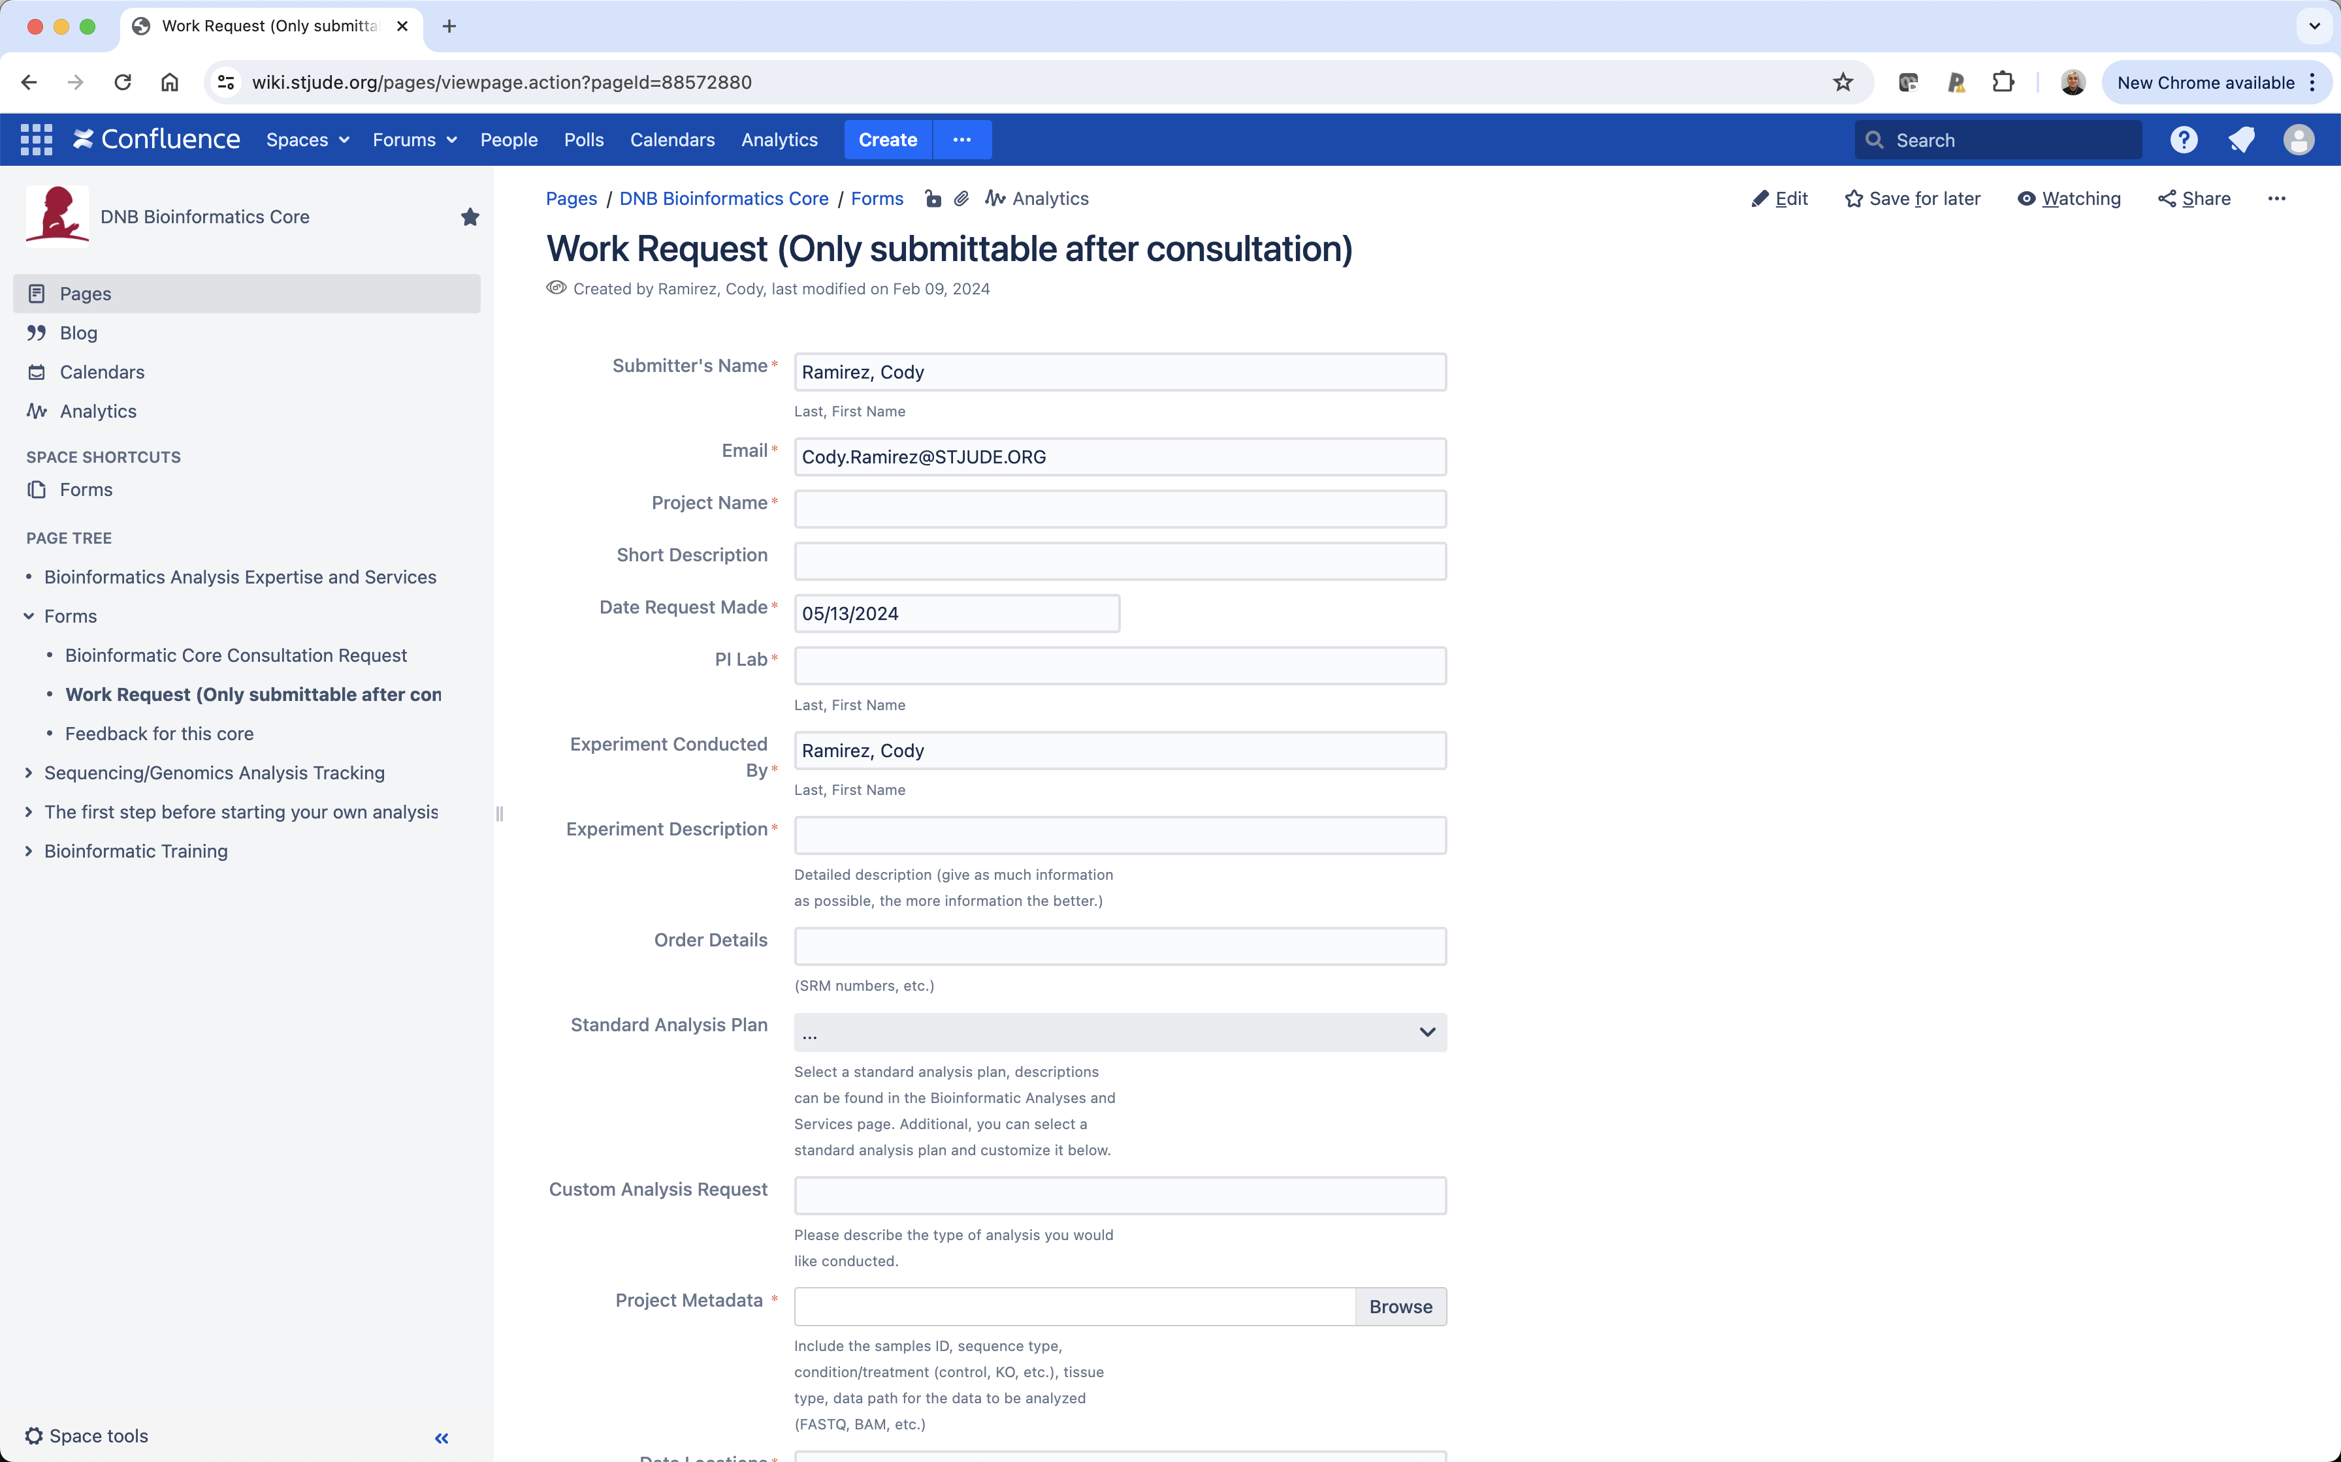
Collaborate with us! – Work Request

Slide 6


Bioinformatics core, Department of Developmental Neurobiology
Providing advanced bioinformatic services for investigators to leverage omics data
Training
Innovation
Project analysis
Benchmarking
CAB liaison
Consultation
Notes:
Our project analysis and trainings are available at our GitHub account. GitHub is a developer’s platform used for storing, tracking, and collaborating on software/ research projects.
That being said projects at St jude will remain private until publication of the paper related to the project, but they will be accessible to members of the repository.

Slide 7

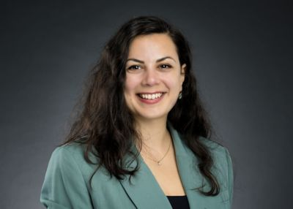
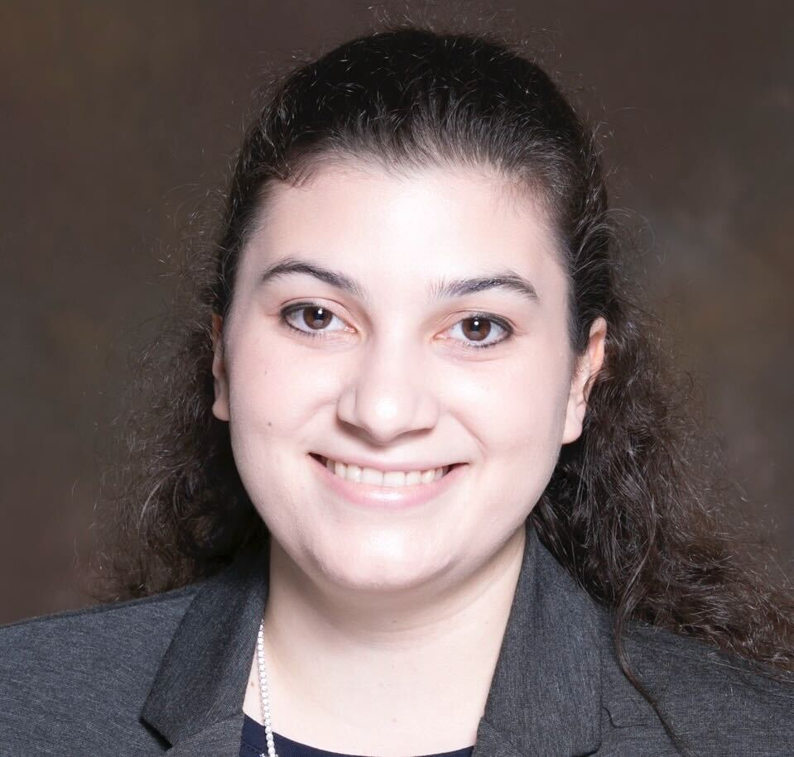
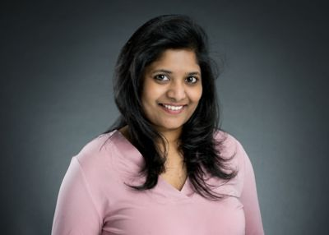
Bioinformatics core, Department of Developmental Neurobiology
Providing advanced bioinformatic services for investigators to leverage omics data
Training
Innovation
Project analysis
Benchmarking
CAB liaison
Consultation
Cody Alexander Ramirez, PhD
Senior Bioinformatics Research Scientist
Core Director
Boston, Massachusetts
Antonia Chroni, PhD
Senior Bioinformatics Research Scientist
New York, New York
Sharon Freshour, PhD
Bioinformatics Research Scientist
St. Louis, Missouri
Asha Jacob Jannu, PhD
Bioinformatics Research Scientist
Indianapolis, Indiana

Slide 8
Agenda
What is bulk RNA-Sequencing?
What can I investigate with RNA-Seq?
Key Steps in RNA-Sequencing
Library preparation
Sequencing technology
Data analysis
CAB AutoMaper RNA-Seq pipeline and QC metrics Standards
Downstream analysis workflow
Notes:
Today’s agenda includes a brief background on what is and how we can leverage gene expression data.
We will discuss the preprocessing and alignment pipeline along with how to read the QC metrics reports generated by CAB. We will discuss some ideas for downstream analysis workflow.

Slide 9
What is bulk RNA-Sequencing?
RNA from a mixed population of cells or tissues
Sequencing to determine the quantity and sequence of RNA transcripts
Average gene expression profile for the entire sample, reflecting the combined expression patterns of all cells within that sample
Yu et al., 2021. Translational Bioinformatics for Therapeutic Development, 143-175.
Notes:
Bulk RNA-seq involves extracting RNA from a mixed population of cells or tissues and sequencing it to determine the quantity and sequence of RNA transcripts.
This method provides an average gene expression profile for the entire sample, reflecting the combined expression patterns of all cells within that sample.
We can measure tissue gene expression levels that are average expression profiles of individual cells so to speak.
So, we sequence a number of reads that you can decide that yourself, what trasncripts are present in your cells, and you aim to have a snapshot of the situation.
https://www.technologynetworks.com/genomics/articles/recent-advances-in-single-cell-genomics-techniques-324695

Slide 10
What can I investigate with RNA-Seq?
Applications
Differential gene expression
Isoform switching
New genes, and transcripts
New transcriptomes
Variants
Allele-specific expression
Alternative splicing
Gene fusion
RNA editing
Exploration of non-model-organism transcriptomes
Yu et al., 2021. Translational Bioinformatics for Therapeutic Development, 143-175.
Notes:
With this information then you can answer various questions so if you have for example two different sample groups, let’s say normal samples and tumor samples, you can look for differentially expressed genes.
You can also see if between those conditions there are differences between isoforms which are expressed.
On the other hand, you can discover new transcripts or even new genes or even ne whole transcriptomes.
You can also look for genomic variants and allele-specific expression.

Slide 11

Advantages and Limitations
High Throughput: Provides comprehensive data on gene expression for thousands of genes simultaneously.
Quantitative: Offers precise measurements of gene expression levels.
Discovery-Oriented: Useful for discovering new genes, isoforms, and regulatory elements.
Lack of Single-Cell Resolution: Bulk RNA-seq averages gene expression across all cells, potentially masking cell-specific variations.
Requires High-Quality RNA: RNA degradation or contamination can affect results.
Complex Data Analysis: Requires sophisticated computational tools and expertise for data processing and interpretation.
Notes:
In summary, bulk RNA-seq is a versatile and powerful tool for investigating gene expression and transcriptome dynamics, with broad applications in research, medicine, and biotechnology.

Slide 12
Advantages and Limitations
High Throughput: Provides comprehensive data on gene expression for thousands of genes simultaneously.
Quantitative: Offers precise measurements of gene expression levels.
Discovery-Oriented: Useful for discovering new genes, isoforms, and regulatory elements.
Lack of Single-Cell Resolution: Bulk RNA-seq averages gene expression across all cells, potentially masking cell-specific variations.
Requires High-Quality RNA: RNA degradation or contamination can affect results.
Complex Data Analysis: Requires sophisticated computational tools and expertise for data processing and interpretation.
Notes:
RNA is fragile compared to DNA (easily degraded)

Slide 13
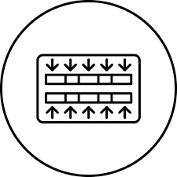

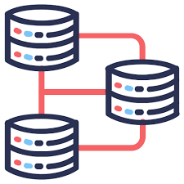

Key Steps in RNA-Seq
Library Preparation
Isolate RNA from the cells or tissues of interest
Convert RNA into complementary DNA (cDNA) and prepare sequencing libraries
Sequencing technology (e.g., Illumina, Oxford Nanopore)
Data Analysis
Alignment of reads against a reference genome or transcriptome
QC analysis
Data normalization
Quantify gene expression levels and analyze differential expression
Notes:
I am going to walk you through the major steps in the RNA-seq experimental wf.
A typical RNA-seq experimental workflow involves the isolation of RNA from samples of interest, generation of sequencing libraries, use of a high-throughput sequencer to produce hundreds of millions of short transcripts, and alignment of reads against a reference genome or transcriptome, and downstream analysis.

Slide 14
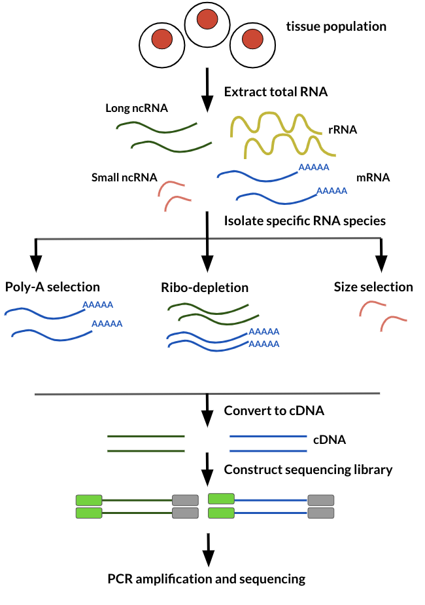
How was the data produced?
Source: Childhood Cancer Data Lab
Notes:
Let’s have a look on what happens in the lab. Bulk RNA-seq data is generated by extracting total RNA and then isolating RNA specific species by either Poly-A selection, Ribo depletion, or size selection. The isolated RNA is then converted to cDNA so it is more stable for sequencing.
Then, we fragment these transcripts or we convert them to double stranded cDNA and fragment that.
The idea with the fragmentation is that typically trasncripts are quite long and illumina sequencing are usually from 10-200 base long reads, so one read is not gonna cover one transcript.
And as the sequencing happens from the ends of the fragments, we need to have as many fragments as we can to cover the whole length of the transcript, so they fragment and the fragmentation happens in random locations.

Slide 15
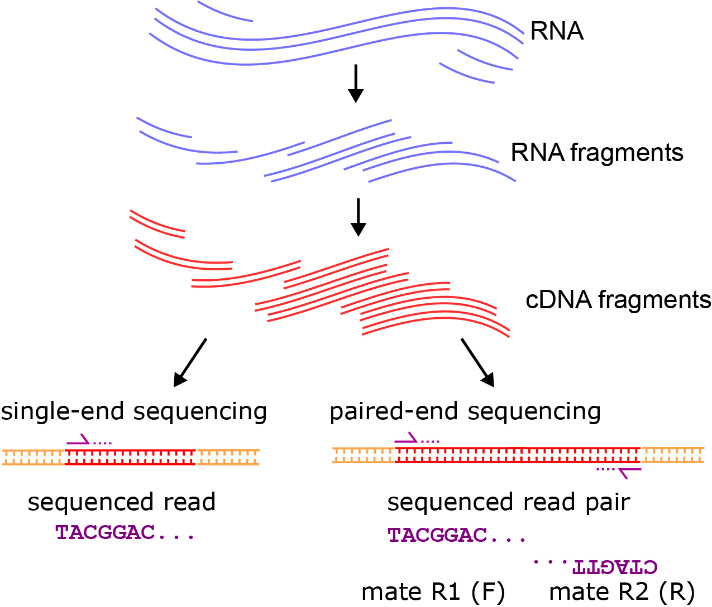
Single-end vs paired-end
Source: https://open.oregonstate.education/appliedbioinformatics/chapter/chapter-6/
Notes:
The sequencing can happen either from one end of the fragment single end sequencing or from both ends of the fragments which is paired-end sequencing.
“The paired-end sequencing is based on the idea that the initial DNA fragments (longer than the actual read length) is sequenced from both sides. This approach results in two reads per fragment, with the first read in forward orientation and the second read in reverse-complement orientation. The distance between both reads is known. Thus, it can be used as an additional piece of information to improve the read mapping.
With paired-end sequencing, each fragment is more covered than with single-end sequencing (only forward orientation sequenced):“

Slide 16
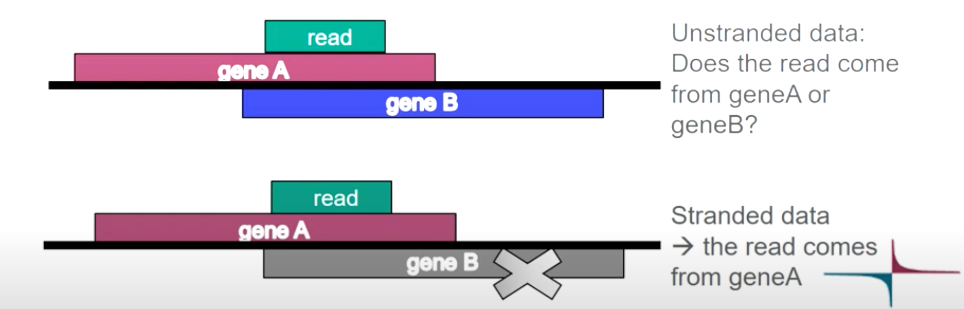
Stranded RNA-Seq data
Indicates if a read maps to same strand where the parental gene is, or to the opposite strand
Useful information when a read maps to a genomic location where there is a gene on both strands
Several lab methods, you need to know which one was used
TruSeq stranded, NEB Ultra Directional, Agilent SureSelect Strand-Specific…
Unstranded data:
Does the read come from geneA or geneB?
Stranded data:
the read comes from geneA
Source: https://cmb.molgen.mpg.de/2ndGenerationSequencing/Solas/RNA-seq.html
Notes:
It is also possible to have so-called stranded data so RNA seq can be stranded and also unstranded.
If it is stranded, it can be stranded in different ways. So, there are several lab methods, and you need to know which one was used when your data was produced.
If you don’t know it’s not a problem as there are analysis tools that can figure that out for you.
So, what does that stradness mean? If you have stranded data, then you can figure out from which strand the parental gene is and this can be useful in situations like this.
Here we have a read which maps to this place in the genome and it happens to be that in that location there are two genes, so geneA on the forward starnd and geneB on the reverse strand.
If our data were produced under unstrained protocol, we wouldn’t be able to tell if this read comes from a transcript from geneA or geneB and so which one is expressed. If we have stranded data, we can resolve this question. So, when it is possible, it is a good idea to have stranded data.

Slide 17
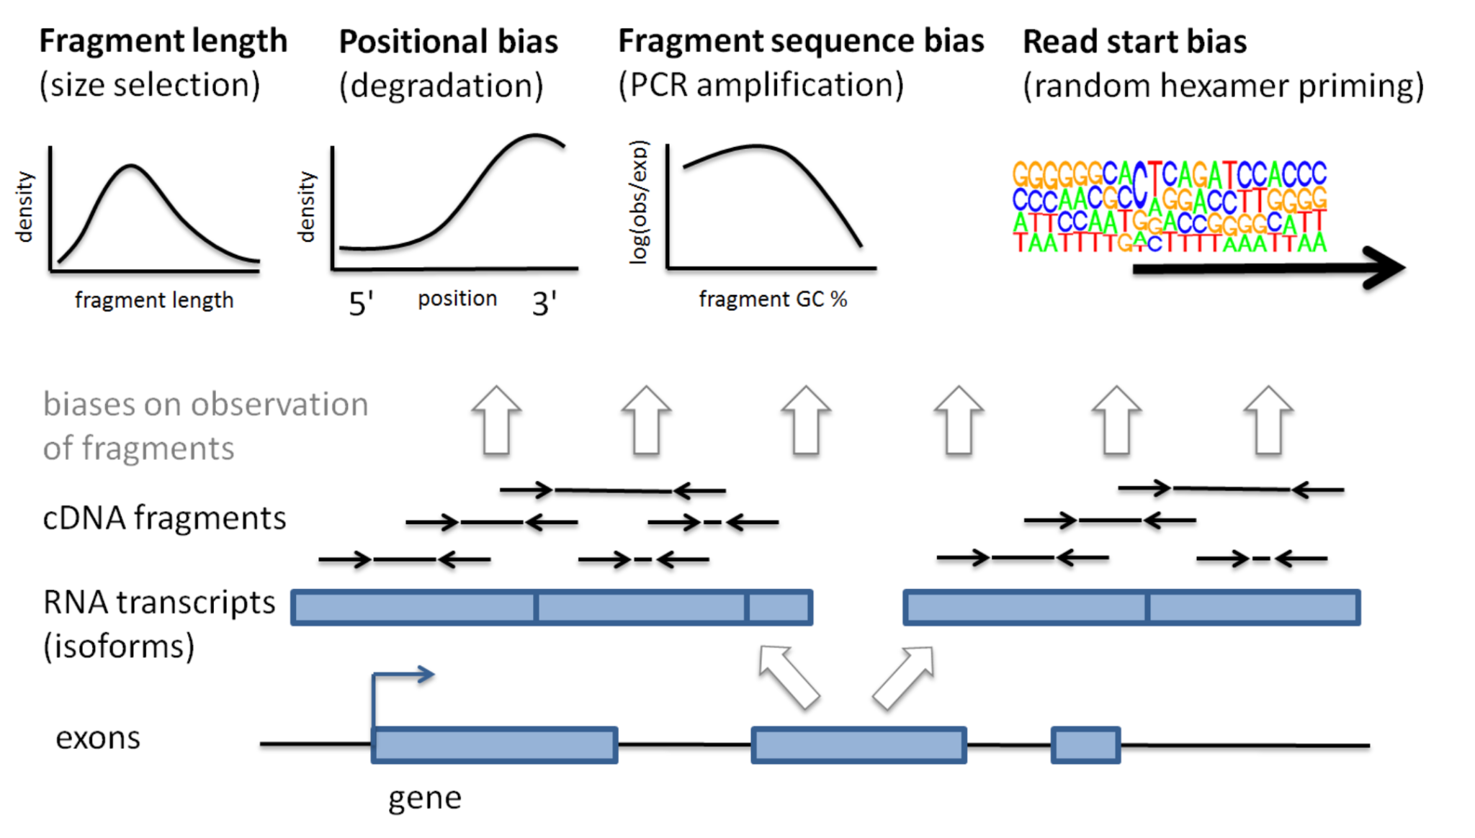
Sequence related biases
3’ bias - 3’ ends of sequences are more likely to be sequenced
GC bias - guanine and cytosine bond melts at higher temp - if a sequence has a lot of G’s and C’s
Sequence complexity - certain sequences more likely to have primers bound to them (and more likely to be sequenced)
Length bias - longer targets are more likely to be amplified or sequenced
Source: `Understanding Gene Expression Data` course by https://www.itcrtraining.org/home
Notes:
RNA targets are more likely to be picked up if they are long, if they are from the 3 prime end, have a particular GC content and have a particular read start sequence.
Ignoring fragment sequence bias impairs transcript abundance estimation when isoform-specific regions have GC content or sequence features that lead to under-representation of fragments, resulting in false positives of predicted expression of isoforms that are expressed poorly or not at all.
https://mikelove.wordpress.com/2016/09/26/rna-seq-fragment-sequence-bias/

Slide 18
Sequence related biases
3’ bias - 3’ ends of sequences are more likely to be sequenced
GC bias - guanine and cytosine bond melts at higher temp - if a sequence has a lot of G’s and C’s
Sequence complexity - certain sequences more likely to have primers bound to them (and more likely to be sequenced)
Length bias - longer targets are more likely to be amplified or sequenced
Source: `Understanding Gene Expression Data` course by https://www.itcrtraining.org/home
Notes:
Sequence related biases GC bias - guanine and cytosine bond melts at higher temp - if a sequence has a lot of G’s and C’s.

Slide 19
Sequence related biases
3’ bias - 3’ ends of sequences are more likely to be sequenced
GC bias - guanine and cytosine bond melts at higher temp - if a sequence has a lot of G’s and C’s
Sequence complexity - certain sequences more likely to have primers bound to them (and more likely to be sequenced)
Length bias - longer targets are more likely to be amplified or sequenced
Source: `Understanding Gene Expression Data` course by https://www.itcrtraining.org/home
Notes:
Sequence complexity - certain sequences more likely to have primers bound to them (and more likely to be sequenced).

Slide 20
Sequence related biases
3’ bias - 3’ ends of sequences are more likely to be sequenced
GC bias - guanine and cytosine bond melts at higher temp - if a sequence has a lot of G’s and C’s
Sequence complexity - certain sequences more likely to have primers bound to them (and more likely to be sequenced)
Length bias - longer targets are more likely to be amplified or sequenced
Source: `Understanding Gene Expression Data` course by https://www.itcrtraining.org/home
Notes:
Length bias - longer targets are more likely to be amplified or sequenced. These biases are worsened by PCR amplification!
Many of these biases are worsened by PCR amplification!

Slide 21
Sequence related biases: example
Source: Love et al. 2016, Nature Biotechnology.
Notes:
Example of length bias

Slide 22
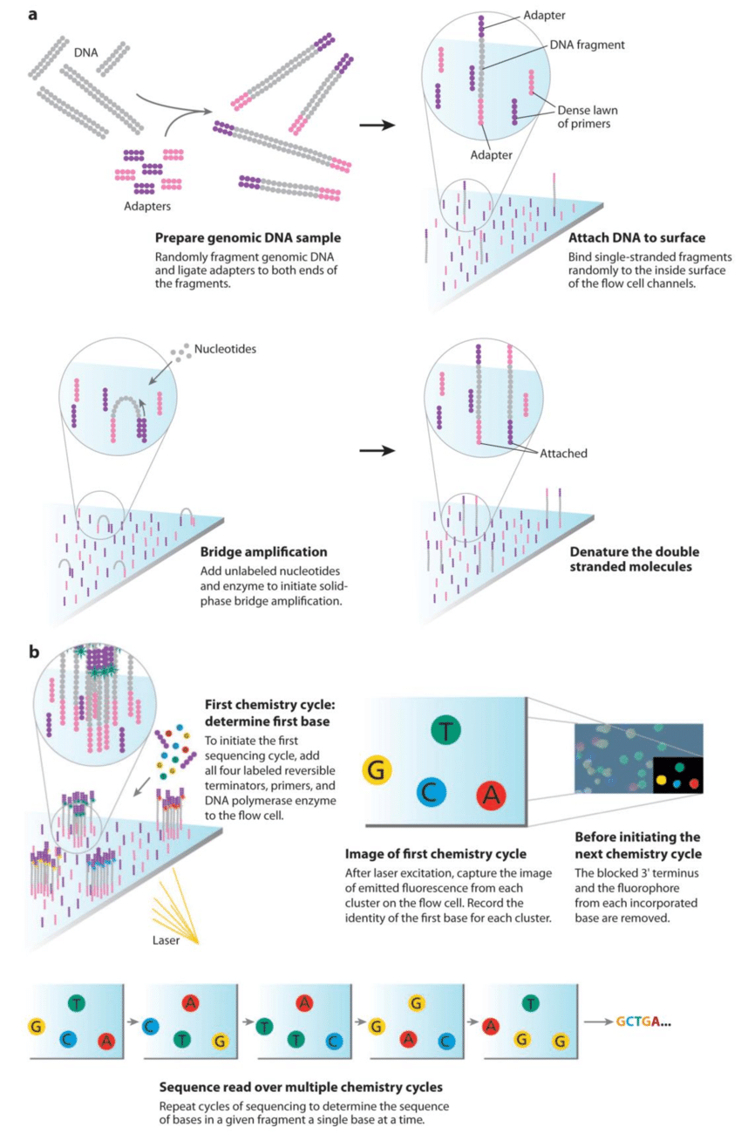
RNA-Seq technology: Illumina sequencing (typically Hartwell)
Sample Preparation
RNA Quality Assessment
Library Preparation
cDNA Synthesis
Fragmentation
Adapter Ligation
Library Amplification
PCR Amplification
Notes:
Illumina sequencing, often associated with high-throughput and accurate sequencing technologies, is a popular choice for bulk RNA-Seq. Here’s a detailed breakdown of the steps involved, including specific details relevant to the Hartwell Lab’s typical protocols:

Slide 23
RNA-Seq technology: Illumina sequencing (typically Hartwell)
Notes:
Library Loading: Load the prepared library onto an Illumina flow cell. The flow cell contains lanes where the library fragments will bind and be sequenced.
Sequencing by Synthesis (SBS): Perform the sequencing on an Illumina platform (e.g., NovaSeq, HiSeq, MiSeq). The SBS process involves:
Cluster Generation: The cDNA fragments are clonally amplified on the flow cell to create clusters of identical sequences.
Sequencing: The clusters are sequenced using SBS technology, which reads the sequence of each fragment as nucleotides are incorporated.

Slide 24
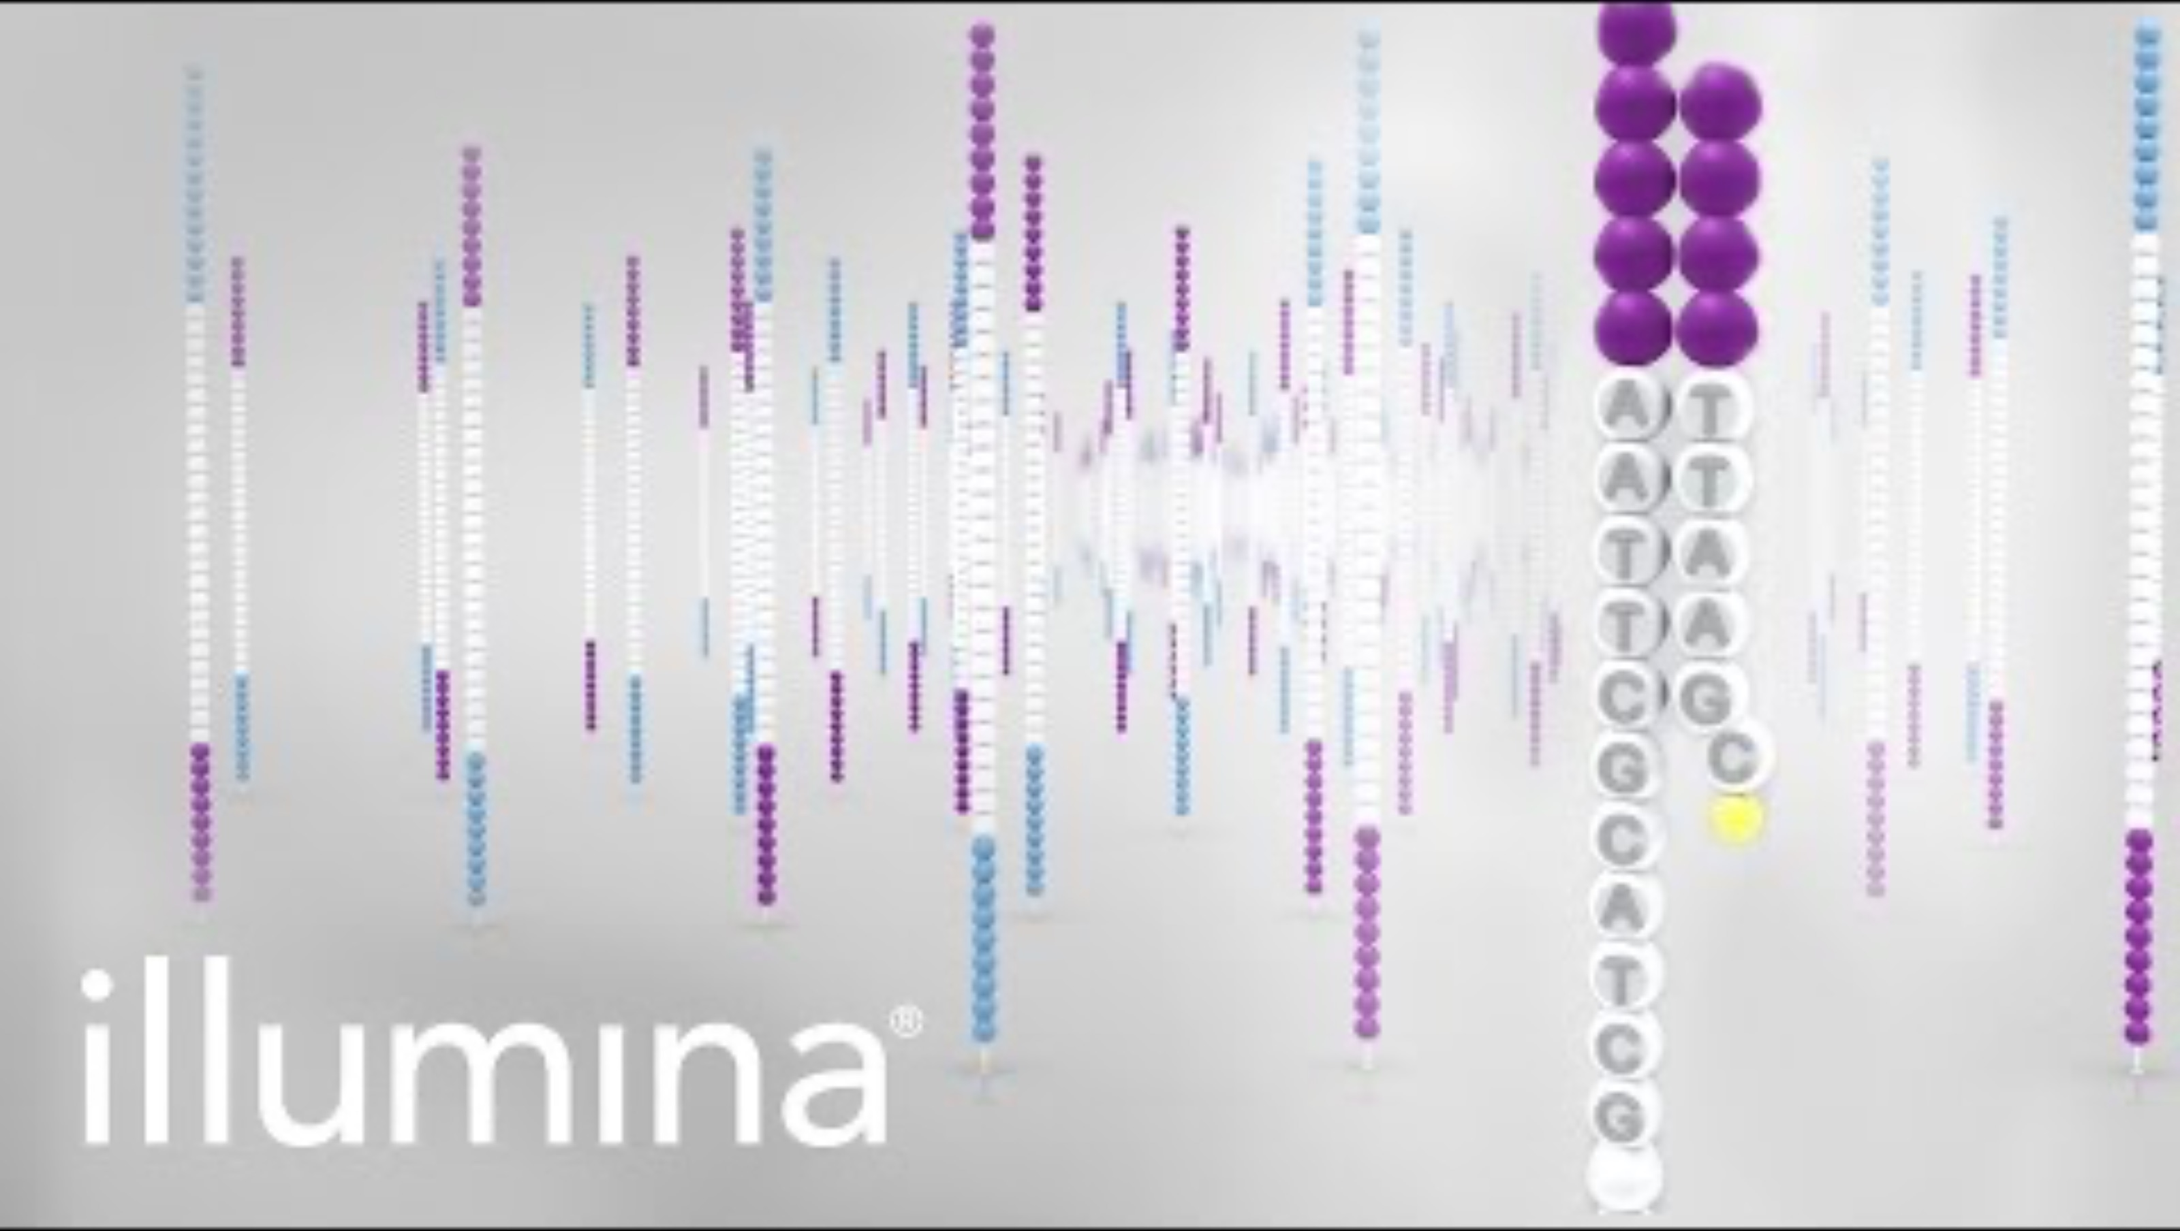
RNA-Seq technology: Illumina sequencing (typically Hartwell)
Overview of Illumina Sequencing by Synthesis Workflow
Notes:
Number of cycles determines the number of reads.
https://www.youtube.com/watch?v=fCd6B5HRaZ8

Slide 25
RNA-seq computational workflow
Source (edited): `Understanding Gene Expression Data` course by https://www.itcrtraining.org/home
Notes:
In a very general sense, RNA-seq workflows involves first quantification/alignment. You will also need to conduct quality control steps that check the quality of the sequencing done. You may also want to trim and filter out data that is not trustworthy. After you have a set of reliable data, you need to normalize your data. After data has been normalized you are ready to conduct your downstream analyses. This will be highly dependent on the original goals and questions of your experiment. It may include dimension reduction, differential expression, or any number of other analyses.

Slide 26
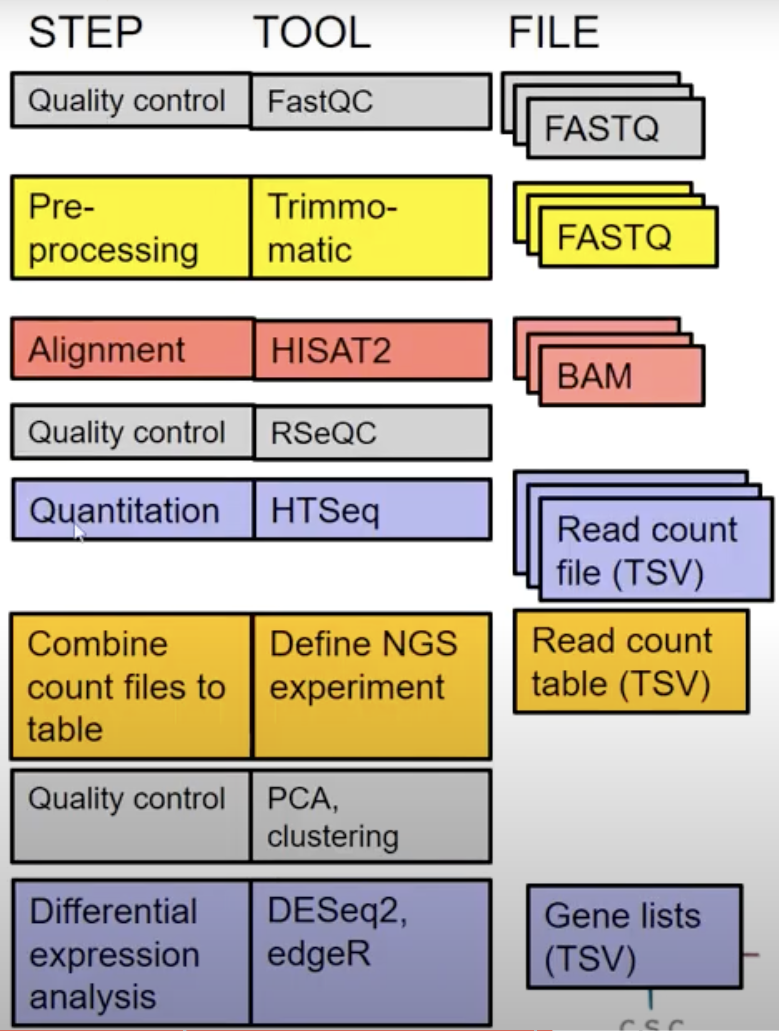
RNA-seq computational workflow
😱🙄
So many steps, tools and files..
Notes:
In reality, it is a bit more complicated, and we actually have a bit more steps and decisions to make.
We are going to discuss these steps in the next slides. For each step there is an analysis tool with each to require a specific file format as shown here.

Slide 27
RNA-seq computational workflow
Source (edited): `Understanding Gene Expression Data` course by https://www.itcrtraining.org/home

Slide 28

Alignment and QC: CAB AutoMaper RNA-Seq pipeline

Slide 29
What is a FASTQ file?
Source: `Understanding Gene Expression Data` course by https://www.itcrtraining.org/home

Slide 30
What is a FASTQ file?
Source: `Understanding Gene Expression Data` course by https://www.itcrtraining.org/home

Slide 31
What is a FASTQ file?
Source: `Understanding Gene Expression Data` course by https://www.itcrtraining.org/home

Slide 32
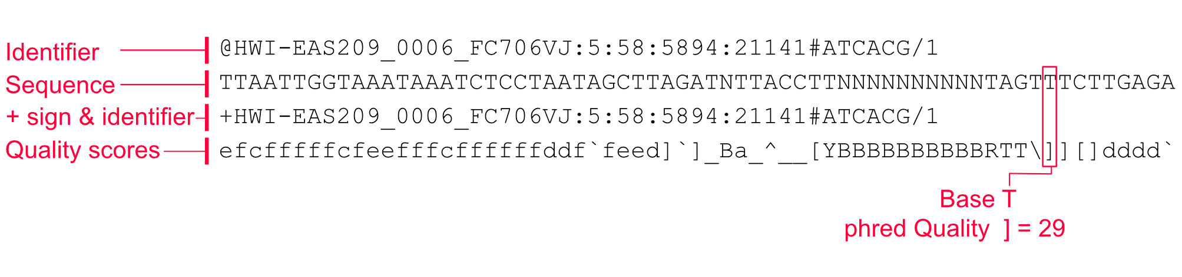
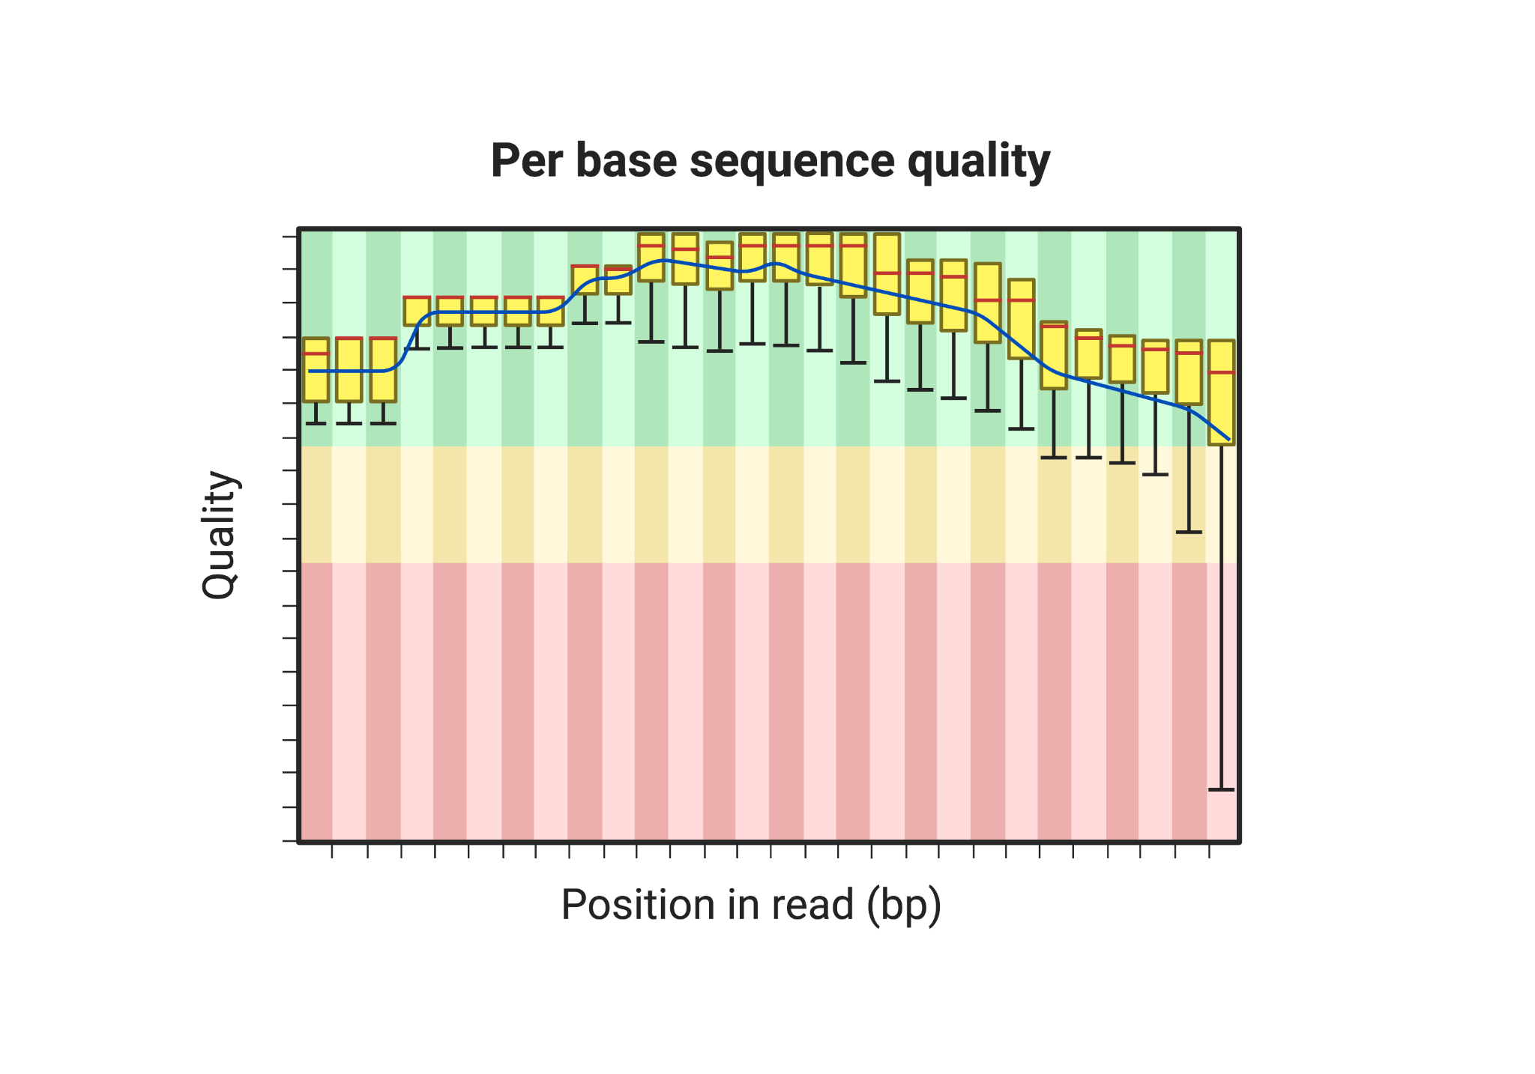
What is a FASTQ file?
Source: `Understanding Gene Expression Data` course by https://www.itcrtraining.org/home
Notes:
What is phred score?
A Phred score is a measure of the quality of a nucleotide base call in DNA sequencing. It was developed by Phil Green and named after him.
The score quantifies the probability that a given base call is incorrect, with higher scores indicating higher confidence in the accuracy of the base call.
In simpler terms, a Phred score is used to assess the reliability of the data obtained from sequencing.
The score is logarithmically related to the probability of an error, so a higher score means a lower chance of an error. For example, a Phred score of 20 indicates a 1 in 100 chance of an error (or a 99% accuracy), while a Phred score of 30 indicates a 1 in 1000 chance of an error (or a 99.9% accuracy).
Phred scores are widely used in bioinformatics and genomics to evaluate and filter sequencing data, helping to ensure that the analysis is based on high-quality information.

Slide 33
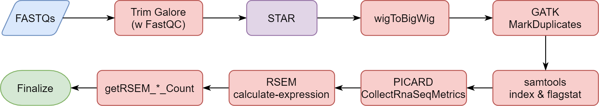
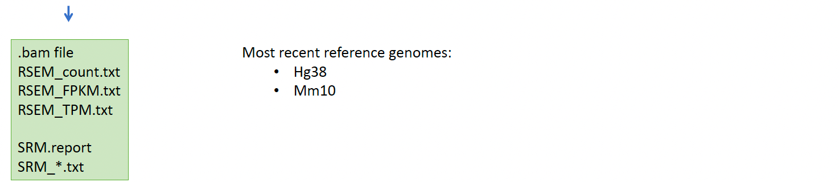
CAB AutoMaper RNA-Seq pipeline
By Dr. Yawei Hui
https://wiki.stjude.org/display/CAB/AutoMapper#AutoMapper-E.RNA-sequencing(RNA-seq)
Notes:
This is the general cab pipeline showing how the alignment occurs, de-duplicate reads, index them, calculate expression. Expression files come in different files based on normalization
-MARKDUPLICATES: marks duplicates– you don’t want to remove them, same read per kb
-PICARD: basic calculations for everything

Slide 34
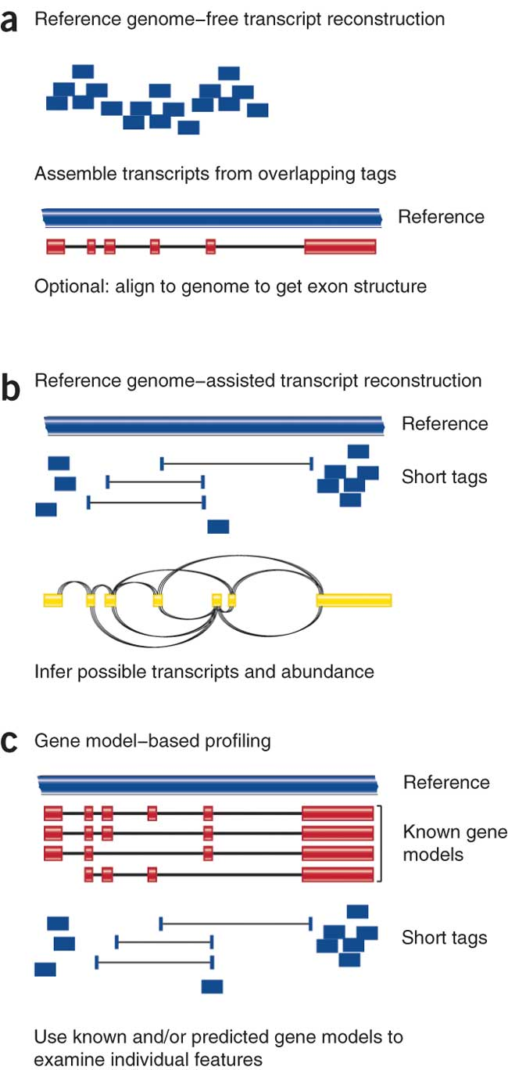
RNA-Seq mapping strategies
RSEM (RNA-Seq by Expectation Maximization) is an accurate and user-friendly software tool for quantifying transcript abundances from RNA-Seq data.
As it does not rely on the existence of a reference genome, it is particularly useful for quantification with de novo transcriptome assemblies.
RSEM has enabled valuable guidance for cost-efficient design of quantification experiments with RNA-Seq, which is currently relatively expensive.
De novo assembly
Align to transcriptome
Align to reference genome
Diagrams from Cloonan & Grimmond, Nature Methods 2010
Notes:
RSEM (RNA-Seq by Expectation Maximization) is an accurate and user-friendly software tool for quantifying transcript abundances from RNA-Seq data. As it does not rely on the existence of a reference genome, it is particularly useful for quantification with de novo transcriptome assemblies. In addition, RSEM has enabled valuable guidance for cost-efficient design of quantification experiments with RNA-Seq, which is currently relatively expensive.

Slide 35
Quality assessment and Quality scores (QC)
RNA Integrity Number (RIN) range: 0 – 10 (In lab)
Source: https://github.com/griffithlab/rnaseq_tutorial_wiki
Notes:
RNA Quality Assessment -> Quality Check: Evaluate RNA integrity and quantity using:
Bioanalyzer/TapeStation: Measure RNA Integrity Number (RIN) or RNA Quality Score (RQS). A high RIN (>7) indicates good quality RNA.

Slide 36
CAB AutoMaper RNA-Seq pipeline: QC matrix
Notes:
RAW: Reads included in the original FASTQs.
TRIMMED: Reads extracted from the raw reads after adapter trimming by using "trim-galore".
MAPPED: Reads include uniquely and multiple mapped reads while excluding those mapped to too many loci.
UNMAPPED: Reads include unmapped reads due to 1) too many mismatches; 2) too short; 3) all other.
ATTENTION: Starting from Nov. 22nd, 2020, the RNAseq mapping pipeline is updated to deliver a BAM file with duplicate reads marked by GATK, after it is generated by STAR.

Slide 37
CAB AutoMaper RNA-Seq pipeline: QC matrix
RAW: Reads included in the original FASTQs

Slide 38
CAB AutoMaper RNA-Seq pipeline: QC matrix
TRIMMED: Reads extracted from the raw reads after adapter trimming by using "trim-galore"

Slide 39
CAB AutoMaper RNA-Seq pipeline: QC matrix
MAPPED: Reads include uniquely and multiple mapped reads while excluding those mapped to too many loci

Slide 40
CAB AutoMaper RNA-Seq pipeline: QC matrix
UNMAPPED: Reads include unmapped reads due to 1) too many mismatches; 2) too short; 3) all other

Slide 41
CAB AutoMaper RNA-Seq pipeline: QC matrix
ATTENTION: Starting from Nov. 22nd, 2020, the RNAseq mapping pipeline is updated to deliver a BAM file with duplicate reads marked by GATK, after it is generated by STAR.

Slide 42
CAB AutoMaper RNA-Seq pipeline: QC matrix
Status: PASS/WARNING

Slide 43
CAB AutoMaper RNA-Seq pipeline: QC matrix
Sample | Status | READS
Sample | Status | Raw | Trimmed | Mapped | Unmapped
1402925_DYE2057 | PASS | 183,713,112 | 182,843,098 | 174,654,868 | 8,071,166
1402926_DYE2058 | PASS | 206,911,576 | 206,567,604 | 200,732,364 | 5,705,280
1402927_DYE2059 | PASS | 179,434,874 | 179,063,722 | 173,428,776 | 5,535,678
1402928_DYE2060 | PASS | 175,251,394 | 174,982,466 | 169,957,226 | 4,923,034
1402929_DYE2061 | PASS | 188,300,318 | 187,985,030 | 182,120,406 | 5,762,370
METRICS | WARNING | < 90M |  | < 60M
 | PASS | ≥ 90M |  | ≥ 60M
DESTINATION: smb://gsc.stjude.org/project_space/dyergrp/dyergrp_auto/common/cab/RNASEQ/DYER-133951-STRANDED
Notes:
A sample receiving a "warning" status does not necessarily mean that you can't use the sample for downstream analysis. However, we do suggest follow-up analyses for these samples. Please see the FAQ below for more details. If you are unsure of whether your sample quality is good enough to be used in downstream analysis, please contact the Center for Applied Bioinformatics.
There are two flags: pass/warning – or how far off I am off this difference/pass

Slide 44
CAB AutoMaper RNA-Seq pipeline: QC matrix
Read Alignment and Distribution

Slide 45
Read Alignment and Distribution
Majority of reads to be in exons
A large number of intronic/intergenic reads can indicate DNA contamination
But a high number of intronic reads may be expected for total RNA preparations as pre-mRNAs are not explicitly excluded.
DNA contamination is usually apparent by eye when viewing in IGV, as many intergenic reads will be apparent.
Nascent transcription (which brain tissue has a lot of) and high levels of transcriptional activity can contribute to a high number of intronic reads. As such, these ranges can vary quite a bit by tissue/cell type and library preparation methods.
Notes:
Generally, we expect a majority of reads to be in exons. A large number of intronic/intergenic reads can indicate DNA contamination, but a high number of intronic reads may be expected for total RNA preparations as pre-mRNAs are not explicitely excluded. DNA contamination is usually apparent by eye when viewing in IGV, as many intergenic reads will be apparent. Additionally, nascent transcription (which brain tissue has a lot of) and high levels of transcriptional activity can contribute to a high number of intronic reads. As such, these ranges can vary quite a bit by tissue/cell type and library preparation methods.

Slide 46
Read Alignment and Distribution
Typical ranges for PolyA selected libraries
Exonic reads: 60-90%
Intronic reads: Up to 30%
Intergenic reads: <10%
Notes:
If you are slightly off this distribution, it might be okay.
If it’s way away from distribution, you may be concerned, and you should reach out for help.

Slide 47
Read Alignment and Distribution
Sample | Status | RATE (%) |  |  | BASE (%)
 |  |  |  |  | Exonic |  | Intron | Intergenic | Ribosomal
Sample |  | Mapped | Unmapped | Duplication | Coding | UTR | Intron | Intergenic | Ribosomal
1402925_DYE2057 | PASS | 95.52 | 4.41 | 43.69 | 26.00 | 20.12 | 32.12 | 20.91 | 0.85
1402926_DYE2058 | PASS | 97.18 | 2.76 | 39.98 | 24.06 | 19.15 | 35.74 | 20.30 | 0.75
1402927_DYE2059 | PASS | 96.85 | 3.09 | 44.82 | 29.18 | 22.54 | 23.01 | 24.14 | 1.14
1402928_DYE2060 | PASS | 97.13 | 2.81 | 42.16 | 25.71 | 20.14 | 31.88 | 21.37 | 0.90
1402929_DYE2061 | PASS | 96.88 | 3.07 | 45.22 | 31.07 | 24.31 | 20.42 | 23.08 | 1.12
METRICS | WARNING | < 85 | > 5 | > 40 | < 60 |  | > 30 | > 10 | > 15
 | PASS | ≥ 85 | ≤ 5 | ≤ 40 | ≥ 60 |  | ≤ 30 | ≤ 10 | ≤ 15
Notes:
Extension of the previous table (missing part of the table) but this summarizes up the metrics that will indicate pass/warning for the sample.

Slide 48
RNA-seq computational workflow
Source (edited): `Understanding Gene Expression Data` course by https://www.itcrtraining.org/home

Slide 49
Data normalization

Slide 50
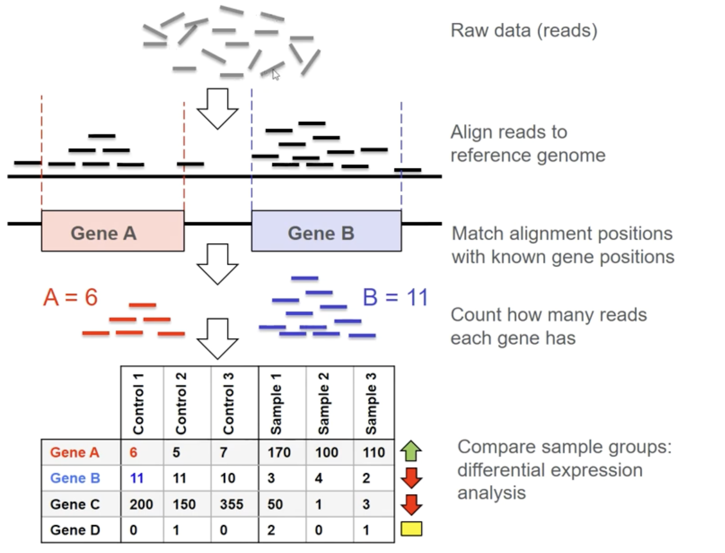
Demo data
Notes:
Now let’s look into the aforementioned steps involved.
So, when you have your raw data, essentially you have your sequencing reads so, let’s say about 100 base pair long sequences. Now we need to put identity on them. Where do they come from?
To do that, we align these reads to the reference genome. Once we know their location in the reference genome, we can compare that information to the annotation information of that genome.
In other words, we know where the genes are located, eg we know gene A and geneB is here.
Then we match that information with the reads and then we can just count the number of the reads per gene, e.g. genea has 6reads and geneb has 11 reads. Essentially this is an estimate of the expression level of that gene.
We do this for all the samples and then we can combine the results eg to a table. So here we have six samples from 2 different groups, and the gens and their reads per sample.
This is of course a simplification but this can give uou the idea of what we are doing.

Slide 51
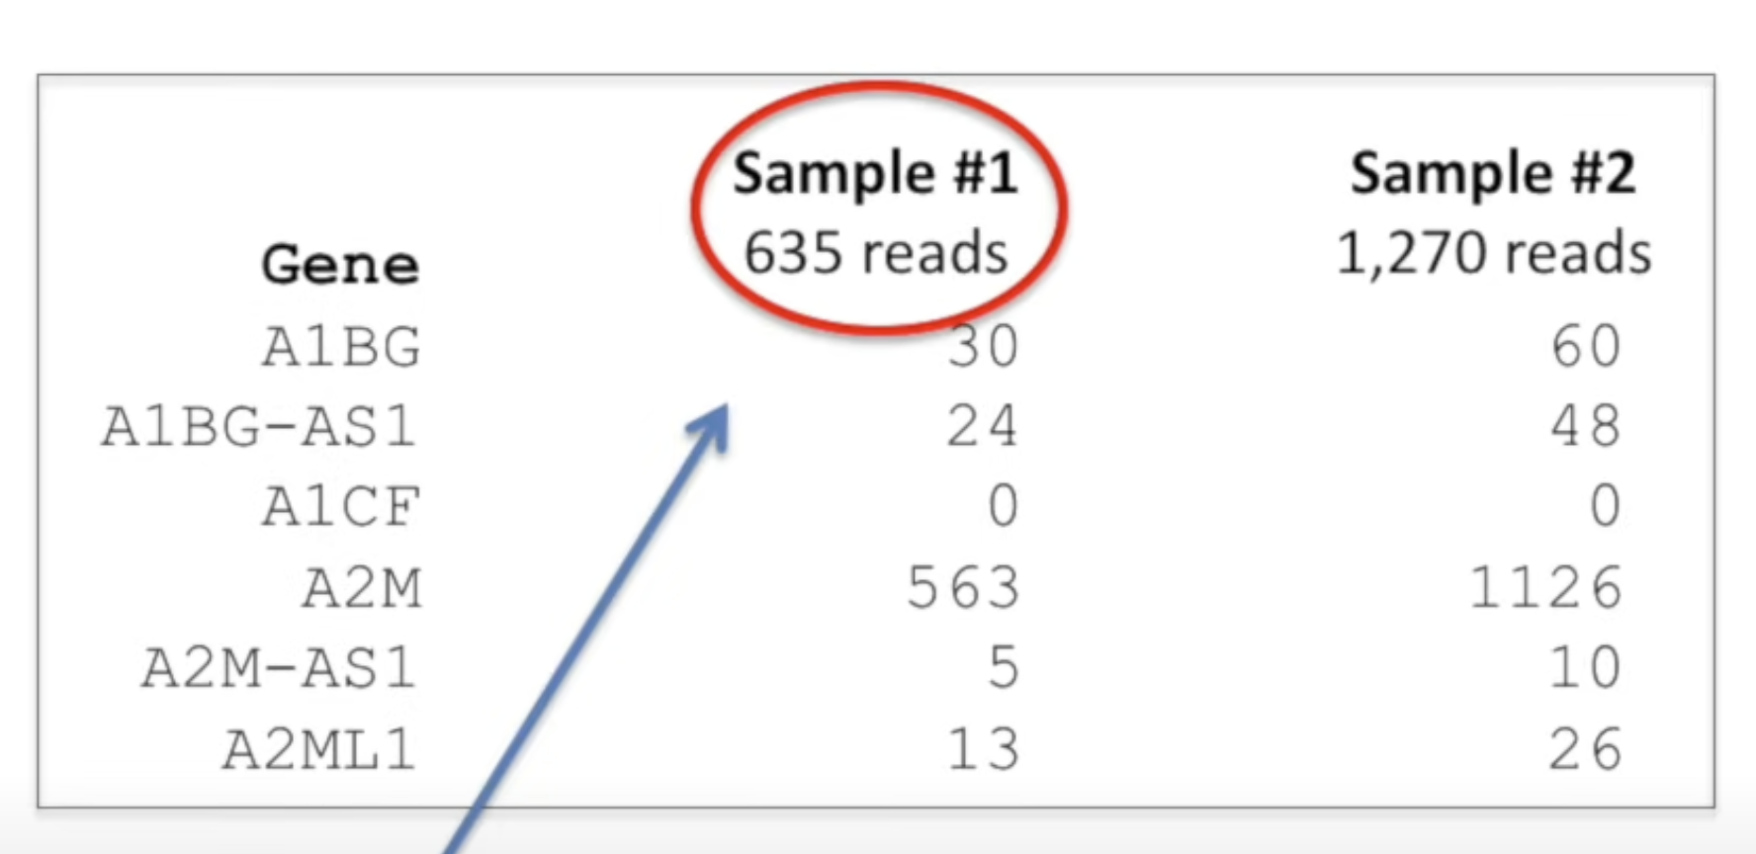
Data normalization
Each sample will have different number of reads assigned to it due to the fact that one sample might have more low quality reads, or another sample might have a slightly higher concentration on the flow cell.

Slide 52
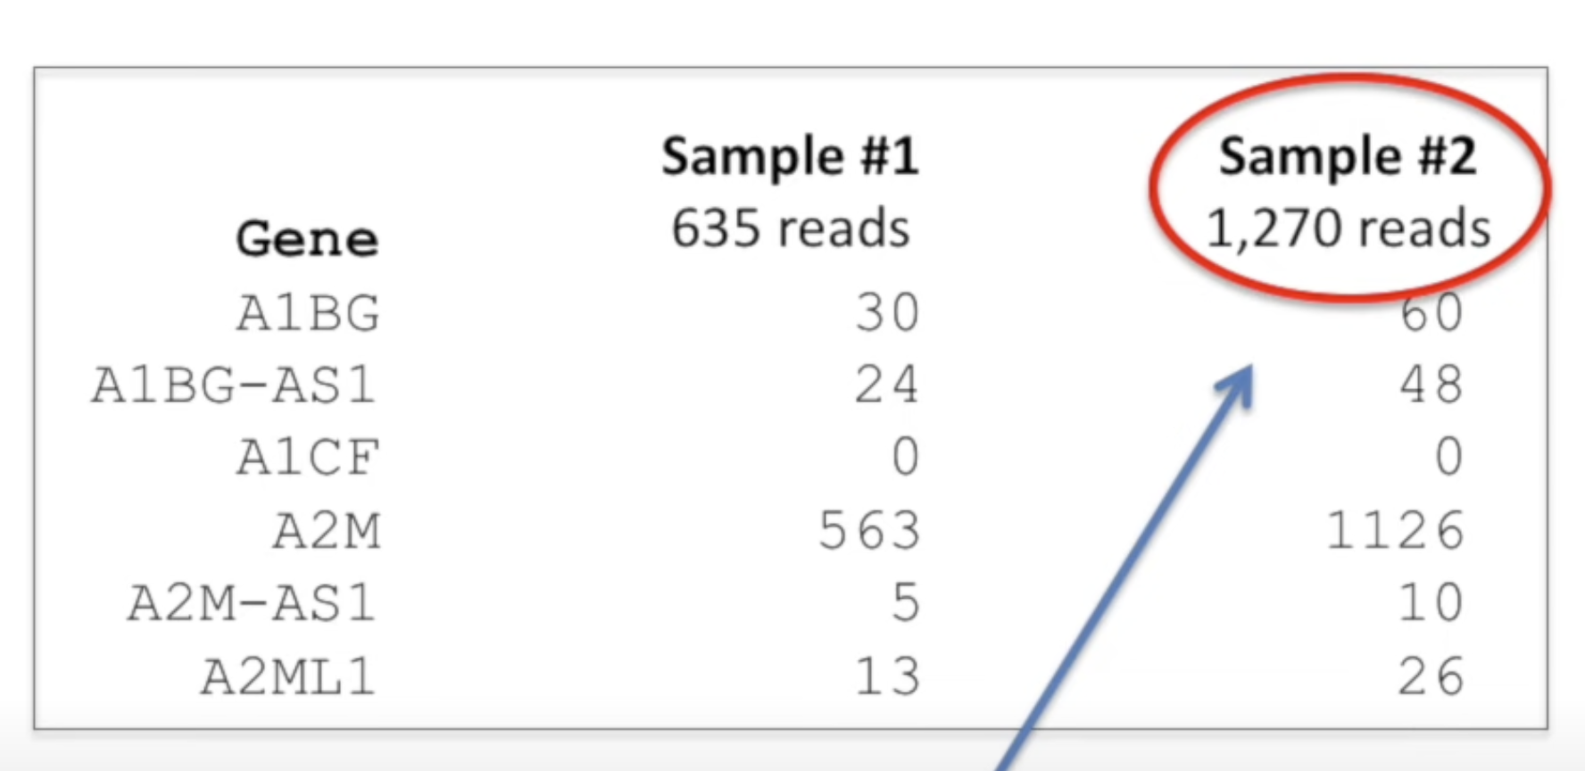
Data normalization
Each sample will have different number of reads assigned to it due to the fact that one sample might have more low quality reads, or another sample might have a slightly higher concentration on the flow cell.
Notes:
This doesn’t mean that the genes in sample 2 were transcribed twice as much as in the sample 1. but that the sample2 had fewer low-quality reads and might have landed on more spots on the flow cell than sample1. However, the read counts doesn’t indicate that. So, we need to adjust the reads per gene to reflect the differences in how many reads were assigned to each sample.

Slide 53
Types of normalization
Fragments Per Kilobase Million (FPKM)
FPKM is made for paired-end RNA-seq. With paired-end RNA-seq, two reads can correspond to a single fragment so it doesn’t count the fragment twice. Here’s how you calculate FPKM:
Count up the total fragment in a sample and divide that number by 1,000,000 – this is the “per million” scaling factor.
Divide the fragment counts by the “per million” scaling factor. This normalizes for sequencing depth, giving you fragments per million (FPM)
Divide the FPM values by the length of the gene, in kilobases. This gives you FPKM.
Count per million (CPM)
CPM is calculated the same way as FPKM except it is not normalized by gen length, i.e. it skips the step 3.
CPM: count per million
CPM is calculated the same way as FPKM except it is not normalized by gen length, i.e. it skips the step 3.
TPM: Transcripts Per Kilobase Million
TPM is very similar to FPKM. The only difference is the order of operations. Here’s how you calculate TPM:
Divide the fragment counts by the length of each gene in kilobases. This gives you fragments per kilobase (FPK).
Count up all the FPK values in a sample and divide this number by 1,000,000. This is your “per million” scaling factor.
Divide the FPK values by the “per million” scaling factor. This gives you TPM.
By Dr. Gang Wu: https://wiki.stjude.org/display/CAB/RNAseq+differential+gene+expression+analysis

Slide 54
Types of normalization
Fragments Per Kilobase Million (FPKM)
FPKM is made for paired-end RNA-seq. With paired-end RNA-seq, two reads can correspond to a single fragment so it doesn’t count the fragment twice. Here’s how you calculate FPKM:
Count up the total fragment in a sample and divide that number by 1,000,000 – this is the “per million” scaling factor.
Divide the fragment counts by the “per million” scaling factor. This normalizes for sequencing depth, giving you fragments per million (FPM)
Divide the FPM values by the length of the gene, in kilobases. This gives you FPKM.
Count per million (CPM)
CPM is calculated the same way as FPKM except it is not normalized by gene length, i.e. it skips the step 3.
TPM: Transcripts Per Kilobase Million
TPM is very similar to FPKM. The only difference is the order of operations. Here’s how you calculate TPM:
Divide the fragment counts by the length of each gene in kilobases. This gives you fragments per kilobase (FPK).
Count up all the FPK values in a sample and divide this number by 1,000,000. This is your “per million” scaling factor.
Divide the FPK values by the “per million” scaling factor. This gives you TPM.
When you use TPM, the sum of all TPMs in each sample are the same. This makes it easier to compare the proportion of fragment that mapped to a gene in each sample.
In contrast, FPKM, the sum of the normalized fragments in each sample may be different, and this makes it harder to compare samples directly.
By Dr. Gang Wu: https://wiki.stjude.org/display/CAB/RNAseq+differential+gene+expression+analysis

Slide 55
Types of normalization
Fragments Per Kilobase Million (FPKM)
FPKM is made for paired-end RNA-seq. With paired-end RNA-seq, two reads can correspond to a single fragment so it doesn’t count the fragment twice. Here’s how you calculate FPKM:
Count up the total fragment in a sample and divide that number by 1,000,000 – this is the “per million” scaling factor.
Divide the fragment counts by the “per million” scaling factor. This normalizes for sequencing depth, giving you fragments per million (FPM)
Divide the FPM values by the length of the gene, in kilobases. This gives you FPKM.
Count per million (CPM)
CPM is calculated the same way as FPKM except it is not normalized by gene length, i.e. it skips the step 3.
Transcripts Per Kilobase Million (TPM)
TPM is very similar to FPKM. The only difference is the order of operations. Here’s how you calculate TPM:
Divide the fragment counts by the length of each gene in kilobases. This gives you fragments per kilobase (FPK).
Count up all the FPK values in a sample and divide this number by 1,000,000. This is your “per million” scaling factor.
Divide the FPK values by the “per million” scaling factor. This gives you TPM.
--------------------------
* When you use TPM, the sum of all TPMs in each sample are the same. This makes it easier to compare the proportion of fragment that mapped to a gene in each sample. In contrast, FPKM, the sum of the normalized fragments in each sample may be different, and this makes it harder to compare samples directly. *
By Dr. Gang Wu: https://wiki.stjude.org/display/CAB/RNAseq+differential+gene+expression+analysis
Notes:
Plus the raw counts: you will get all 4 files from CAB along with the QC reports.
Plotting and comparing differential expression are different!
More common files these days: CPM, TPM
Ratio distribution: individual ration per sample;
10 samples before; now it is 2 that you can collapse and get signal from (because of the sequence depth is higher) – min req of min 2 samples

Slide 56
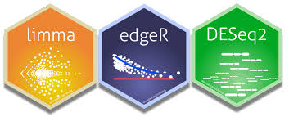
Differential expression analysis (Limma voom)
Read counts per gene (raw count data) are analyzed using R software using the following methods:
Only confidently annotated (level 1 (verified) and 2 (manually annotated) gene annotation)
Protein-coding genes are considered in the standard differential expression analysis.
Low count genes were removed from analysis using a CPM cutoff corresponding to a count of 10 reads.
Normalization factors were generated using the TMM method.
Counts were normalized using voom.
Voom normalized counts were analyzed using the lmFit and eBayes functions of the limma software package.
MA plots were generated from voom normalized data and volcano plots generated from voom normalized data plus p-values values from limma.
Notes:
Normal linear modeling strategies are presented for analyzing read counts from RNA-seq experiments.
The voom method estimates the mean-variance relationship of the log-counts, generates a precision weight for each observation and enters these into the limma empirical Bayes analysis pipeline.
This opens access for RNA-seq analysts to a large body of methodology developed for microarrays. Simulation studies show that voom performs as well or better than count-based RNA-seq methods even when the data are generated according to the assumptions of the earlier methods. Two case studies illustrate the use of linear modeling and gene set testing methods.
-----------------------------------------------
log2FC change: it’s relevant to your experiment.
logCPM: it is comparable across experiments.

Slide 57
RNA-seq computational workflow
Source (edited): `Understanding Gene Expression Data` course by https://www.itcrtraining.org/home
Notes:
After the data has been normalized you are ready to conduct your downstream analyses. This will be highly dependent on the original goals and questions of your experiment. It may include dimension reduction, differential expression, or any number of other analyses.

Slide 58
Downstream analysis workflow
R shiny app/RNAseqV2.3X
Manual on how to use the app
Notes:
Example is preloaded and then you can figure out what you need to analyze/visualize. Or you can use your own data!

Slide 59
Let us help you!
Providing advanced bioinformatic services for investigators to leverage omics data
Training
Innovation
Project analysis
Benchmarking
CAB liaison
Consultation
Cody Alexander Ramirez, PhD
Senior Bioinformatics Research Scientist
Core Director
Boston, Massachusetts
Antonia Chroni, PhD
Senior Bioinformatics Research Scientist
New York, New York
Sharon Freshour, PhD
Bioinformatics Research Scientist
St. Louis, Missouri
Asha Jacob Jannu, PhD
Bioinformatics Research Scientist
Indianapolis, Indiana

